Slide 1
Sociology Course Code (SS 2005)
Muhammad Zeeshan

Slide 2
SOCIETY AND THE INDIVIDUAL
Society is made up of group of individuals.
Without individuals there is no concept of human society.
SOCIETY:- refers to people who live in a defined territory and share a common culture and help each other out in times of need.
According to Gerald Laski societies have evolved over a period of 10,000 years from Primitive to Modern societies. (i.e. from Hunting-Gathering to Post-Modern societies)
Lenski uses the term sociocultural evolution to mean “changes that occur as a society gains new technology”.
As a result of this evolution there has been significant changes in the culture of the human societies as time passes by.

Slide 3
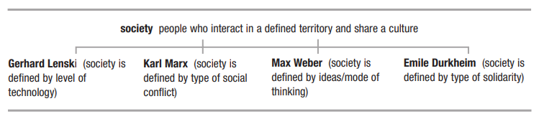
SOCIETY AS DEFINED BY DIFFERENT SOCIOLOGISTS

Slide 4
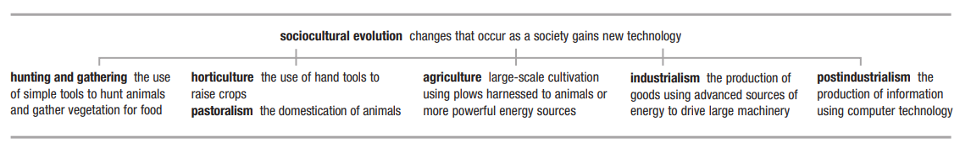
TYPES OF SOCIETIES AS A RESULT OF HUMAN PROGRESS
Consult page no. 83 (Maccionis Book)

Slide 5
SOCIETY AND THE INDIVIDUAL
Culture also has a significant impact on human societies and individual lives of the people living there.
Q: What is culture?
CULTURE:- Culture is a way of life. It is shared by members of a society and shapes that how we act, think, and feel.
Culture is a product of evolution. As the humans evolved, so does culture replaced basic instincts of survival with social progress.

Slide 6
ELEMENTS OF CUTURE:-
There are 5 elements of culture i.e. (symbols, language, values, beliefs and norms).
Symbols: anything that carries a particular meaning recognized by people who share a culture. E.g. Danger Sign, Caution Sign, Traffic Signals, Flags etc.
Language: a system of symbols that allows people to communicate with one another.
Values: culturally defined standards that people use to decide what is desirable, good, and beautiful and that serve as broad guidelines for social living.
Beliefs: specific ideas that people hold to be true e.g. Heaven and Hell.
Norms: rules and expectations by which a society guides the behavior of its members.
Mores: norms that are widely observed and have great moral significance e.g. respecting elders and caring for young ones.
Folkways: norms for routine or casual interaction e.g. greeting someone.

Slide 7
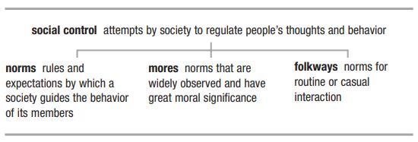
SOCIAL CONTROL
Methods used to control the people thoughts and behavior in a society.

Slide 8
TYPES OF CUTURE:-
There are different types of culture:-
Ideal Culture:- culture that society belives everyone should follow. e.g telling truth, honesty, hardwork, have loyalty, showing respect etc.
Real Culture:-the actual culture in the society e.g cheating, decieving, lethargy, corrupt practices etc.
Material Culture:- the physical things created by members of a society e.g. buildings, clothes, food etc.
Non-Material Culture:- the ideas created by members of a society e.g. values, ethics, beliefs etc.

Slide 9
Culture (Important Concepts)
High culture refers to the cultural patterns of a society’s elite class. i.e. Elite class culture.
Popular culture refers to the cultural patterns that are widespread among a society’s population. Culture of the majority people.
Sub-culture refers to cultural patterns that set apart some segment of a society’s population. e.g. Sindhi culture is a Sub-Culture of Pakistani society.
Multiculturalism is a perspective recognizing the cultural diversity of any society and promoting equal standing for all cultural traditions.
Counterculture refers to cultural patterns that strongly oppose those widely accepted within a society. E.g. Gangs culture, Drug culture etc.

Slide 10
Culture (Important Concepts) Contd…
Cultural Diversity, different cultures present in a specific territory and people following them live peacefully with others. E.g. different cultures of Pakistan.
Cultural integration, the close relationships among various elements of a cultural system
Cultural lag, the fact that some cultural elements change more quickly than others, disrupting a cultural system. (Material culture changing more rapidly than Non-Material culture).
Ethnocentrism, the practice of judging another culture by the standards of one’s own culture e.g. Pakistani culture is better than Indian culture.
Cultural relativism, the practice of judging a culture by its own standards. All cultures are good in their own context.
Cultural universals are traits that are part of every known culture.

Slide 11
Causes of Cultural Change
Cultural changes are set in motion in three ways:-
Invention, the process of creating new cultural elements; like telephone (1876), the airplane (1903), and the computer (late 1940s); each of these elements of material culture has had a tremendous impact on our way of life.
Discovery, a second cause of cultural change, involves recognizing and understanding more fully something already in existence; perhaps a distant star or the foods of another culture or women’s political leadership skills.
Diffusion, the spread of cultural traits from one society to another. Because new information technology sends information around the globe in seconds, cultural diffusion has never been greater than it is today

Slide 12
Individual Assignment: No. 1
Weightage: 2% Marks: 10
Q1: Explain the origins of Sociology discipline. (250-300 words) (5)
Q2: Explain the importance of understanding the Global Perspective in Sociology. (250-300 words) (5)
Important Instructions:-
Write in your own words.
No plagiarism is allowed.
Deadline date for assignment submission: 7th February, 2024

Slide 13
Q&A Session

